Slide 1
微博热榜 mid爬取 难点Ajax动态加载网页
看论文，ICCV2017论文分类 ，论文标题及内容词频统计
尝试使用tensorflow、keras、torch，熟悉编程流程
RCNN DenseNet 结构理解
OpenFace 头部姿态估计Deme (脸部关键点识别、眼神识别等)
调研Autism Diagnosis

Slide 2
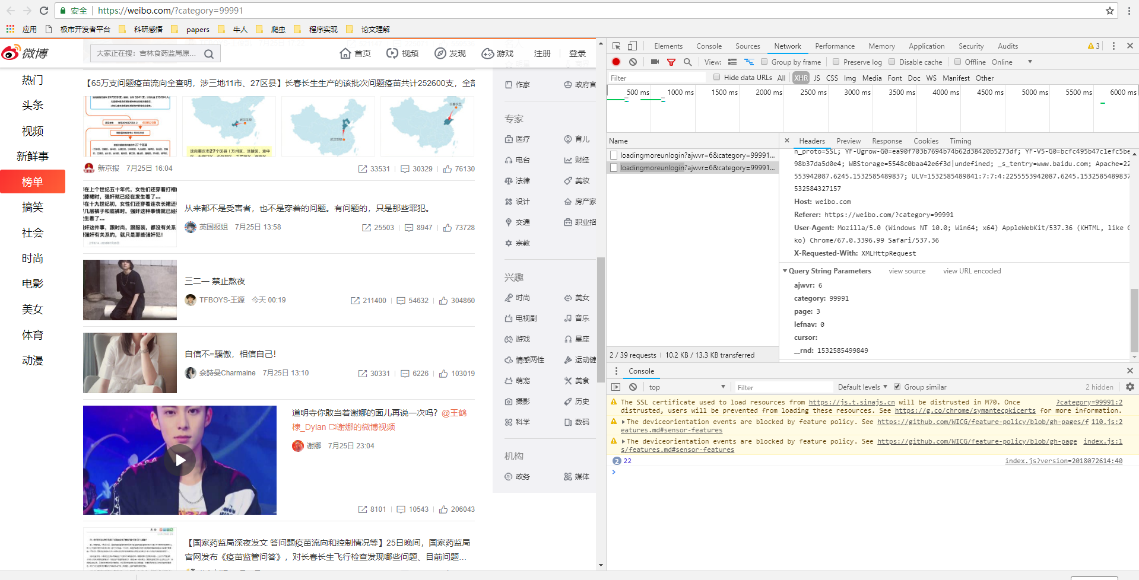

Slide 3
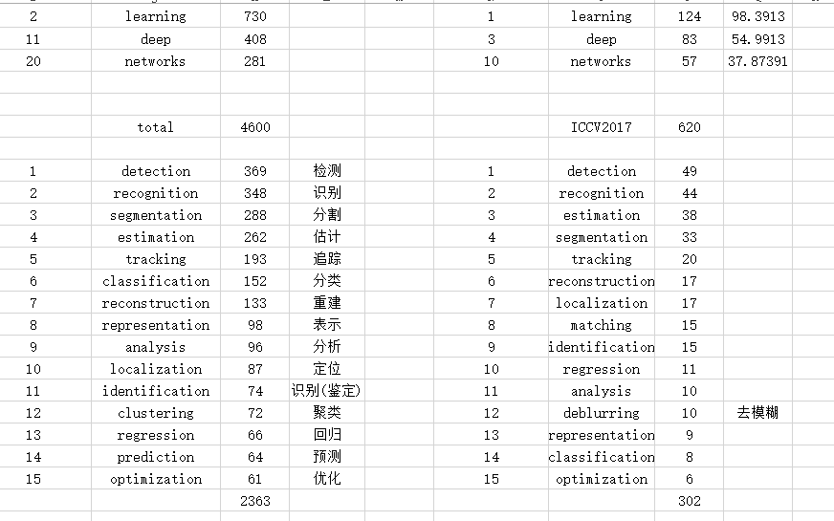

Slide 4
OpenFace
1.人脸特征点识别
2.头部姿态估计
3.眼神估计

Slide 5
Machine Learning for Autism Diagnostics

Slide 6
Autism
Communication and language
Reciprocal social interaction
Restricted activities

Slide 7
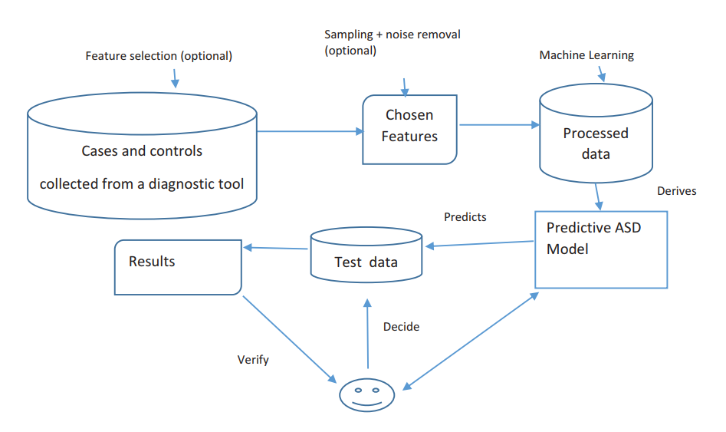
ASD diagnosis as a classification problem

Slide 8
Screening Tool：ADOS-R,ADI-R,etc.

